Slide 1



Credit Risk Modeling
Team:
Pratik Doshi
Swara Vedak
Jinay Gada
Vinit Jhadav

Slide 2
AGENDA
Introduction
Components
Data Analysis
ML Concepts
Prediction &
Conclusion

Slide 3

Introduction
Credit risk modeling helps financial institutions assess the risk of default on loans and credit products. It uses statistical and qualitative models to evaluate a borrower's creditworthiness and helps institutions make informed lending decisions. This improves credit risk management and reduces losses from default, playing a crucial role in the efficient functioning of financial markets.
3

Slide 4


1. Probability of Default 2. Loss Given Default 3. Exposure of Default
Components For credit risk

Slide 5
Areas of growth
Time period | B2B | Supply chain | ROI | E-commerce
Q1 | 4.5 | 2.3 | 1.7 | 5.0
Q2 | 3.2 | 5.1 | 4.4 | 3.0
Q3 | 2.1 | 1.7 | 2.5 | 2.8
Q4 | 4.5 | 2.2 | 1.7 | 70
5

Slide 6
1. Linear Regression 2. Decision Tree Model
DATA ANALYSIS
6

Slide 7
Timeline
Nov 20XX
May 20XX
Disseminate standardized metrics
Deploy strategy networks with compelling e-business needs
Sep 20XX
Synergize scalable
e-commerce
Jan 20XX
Mar 20XX
Coordinate e-business applications
Foster holistically superior methodologies
7

Slide 8

ML Algorithm Concepts
1. Decision Tree
Decision tree is a supervised machine learning algorithm used for classification and regression tasks. It is a tree-like model where each internal node represents a test on a feature, each branch represents the outcome of the test, and each leaf node represents a class label or a numeric value. The decision tree algorithm recursively partitions the data based on the most significant attributes and builds a tree that can be used for prediction.
In classification problems, the decision tree algorithm aims to maximize the information gain at each split, which is a measure of the amount of uncertainty in the data that is removed after the split
8

Slide 9
2. Logistic Regression
Logistic regression is a statistical method used to analyze the relationship between a binary dependent variable (outcome variable) and one or more independent variables (predictors). It is widely used in various fields, including economics, medicine, social sciences, and finance. The method estimates the probability of the occurrence of the dependent variable, given the values of the independent variables.
Logistic regression is a type of regression analysis that is specifically designed to model the relationship between a binary dependent variable and one or more independent variables. The goal of logistic regression is to find the best-fitting model that accurately predicts the probability of the dependent variable taking on one of the two possible values (usually 0 or 1).

Slide 10
Performance Evaluation metrics
Accuracy, precision, recall, F1 score, AUC (Area Under the Curve), and ROC (Receiver Operating Characteristic) curve are performance metrics used to evaluate the performance of binary classification models.
Each matric is explained in the upcoming slides.

Slide 11
Accuracy
Accuracy is a performance metric used to evaluate the performance of a classification model. It represents the percentage of correctly classified instances over the total number of instances. In other words, it measures how often the model correctly predicts the correct class of an instance.
For example, if a model correctly predicts the class of 90 out of 100 instances, the accuracy of the model is 90%. It is calculated as:
Accuracy = (number of correctly classified instances) / (total number of instances)
Number of Correctly Classified Instances = (True Positives + True Negatives) / (True Positives + False Positives + True Negatives + False Negatives)
While accuracy is a useful metric, it can be misleading in certain situations, especially when the dataset is imbalanced or when the cost of misclassification is not the same for all classes. In such cases, other performance metrics such as precision, recall, F1 score, AUC, and ROC curve may be more appropriate.

Slide 12
Precision
Precision is a performance metric that measures the proportion of true positives (correctly identified instances) among all instances that are identified as positive by a classification model. In other words, precision quantifies the model's ability to correctly identify positive instances, without falsely labeling negative instances as positive.
Precision is particularly useful when the cost of a false positive is high, meaning that misclassifying a negative instance as positive can have severe consequences. For example, in a medical diagnosis context, a false positive may lead to unnecessary and potentially harmful treatments for a patient who does not actually have a disease. In such cases, a high precision model is preferred to minimize false positives.
Precision is calculated as the ratio of true positives (TP) to the sum of true positives and false positives (FP):
Precision = TP / (TP + FP)
A perfect precision score of 1.0 indicates that all instances labeled as positive are actually positive, while a score of 0.0 means that none of the instances labeled as positive are actually positive.

Slide 13
Recall
Recall, also known as sensitivity, is a performance metric used in machine learning and classification problems that measures the proportion of actual positive instances that are correctly identified by the model. In other words, it is the ratio of true positives to the total number of actual positives.
Recall is particularly useful in scenarios where correctly identifying all positive instances is more important than minimizing false positives. For example, in a medical diagnosis task, correctly identifying all cases of a disease (true positives) is more critical than wrongly diagnosing a healthy person as having the disease (false positives).
Recall ranges from 0 to 1, where a value of 1 indicates perfect recall, meaning all actual positive instances were correctly identified by the model. Conversely, a recall of 0 indicates that the model failed to identify any actual positive instances correctly.

Slide 14
F1-Score
The F1 score is a measure of a model's accuracy that combines both precision and recall into a single value. It is calculated as the harmonic mean of precision and recall, with values ranging from 0 to 1.
The F1 score is particularly useful in cases where both precision and recall are important, such as in binary classification problems where the classes are imbalanced.
It provides a balance between precision and recall, giving an overall evaluation of the model's performance. A higher F1 score indicates better performance, with a perfect score of 1 indicating that the model has perfect precision and recall.
The F1 score is calculated as:
F1 score = 2 * (precision * recall) / (precision + recall)

Slide 15
AUC (Area Under the Curve)
AUC (Area Under the Curve) is a performance metric that is commonly used in binary classification problems. It is used to evaluate the quality of a model's predictions and is calculated by computing the area under the Receiver Operating Characteristic (ROC) curve.
The ROC curve is a plot of the true positive rate (TPR) against the false positive rate (FPR) at various classification thresholds. The TPR represents the proportion of actual positive cases that are correctly classified as positive, while the FPR represents the proportion of actual negative cases that are incorrectly classified as positive.
The AUC ranges from 0 to 1, with a higher value indicating better performance. An AUC of 0.5 indicates random guessing, while an AUC of 1 indicates perfect classification. AUC is a useful metric when dealing with imbalanced datasets or when the cost of misclassification is not the same for all classes, as it provides an overall measure of model performance that is insensitive to class imbalance.
In summary, AUC is a widely used metric for evaluating the performance of binary classification models, providing a summary of the model's ability to distinguish between positive and negative classes at various classification thresholds.

Slide 16
ROC (Receiver Operating Characteristic)
ROC (Receiver Operating Characteristic) curve is a graphical representation of the performance of a binary classification model, by plotting the true positive rate (TPR) against the false positive rate (FPR) at various classification thresholds. The TPR is also known as recall, sensitivity or hit rate, while the FPR is defined as 1 - specificity.
The ROC curve shows the trade-off between sensitivity and specificity for different threshold values. A random classifier will have an ROC curve that is a straight line at 45 degrees, while a perfect classifier will have an ROC curve that passes through the top left corner of the plot (TPR = 1, FPR = 0). The area under the ROC curve (AUC) is a commonly used metric to evaluate the overall performance of a binary classification model. The AUC ranges from 0 to 1, with higher values indicating better performance.
The ROC curve and AUC are useful for evaluating binary classification models in situations where the class distribution is imbalanced, and the cost of false positives and false negatives may differ. By varying the threshold for classification, the ROC curve allows for exploration of the trade-off between the two types of errors, and provides a visual representation of the model's performance. The AUC is a single number that summarizes the overall performance of the model across all possible threshold values.

Slide 17
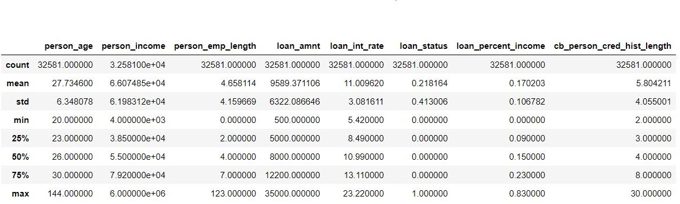
Describing Data-Set

Slide 18
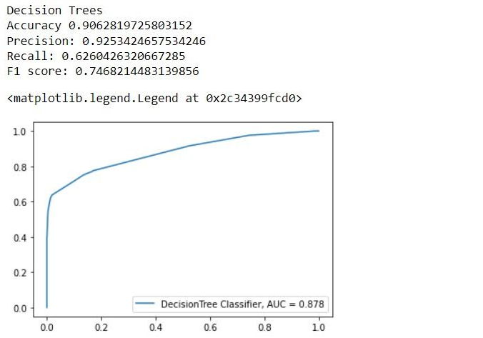
Decision Tree Report
Accuracy: 0.9062
Precision: 0.9253
Recall: 0.6260
F1 Score: 0.7468

Slide 19
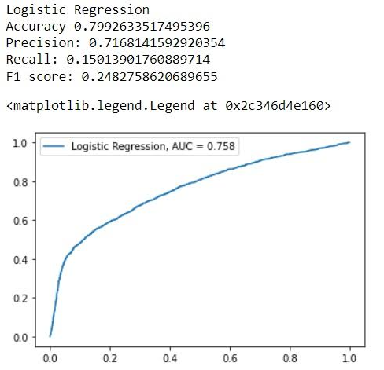
Logistic Regression Report
Accuracy: 0.7992
Precision: 0.7168
Recall: 0.1501
F1 Score: 0.2482

Slide 20
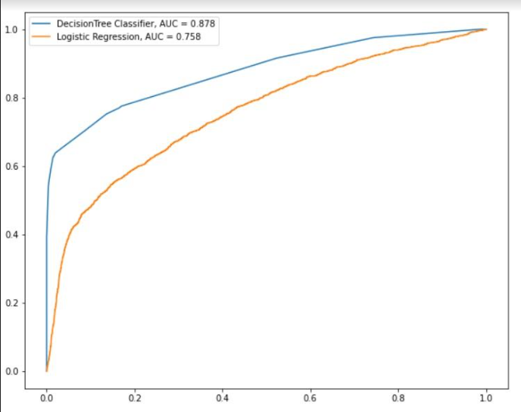
Comparing Logistic Regression & Decision Tree
Decision Tree, (AUC) : 0.878
Logistic Regression, (AUC) : 0.758

Slide 21
How we get there
ROI
Envision multimedia-based expertise and cross-media growth strategies
Visualize quality intellectual capital
Engage worldwide methodologies with web-enabled technologies
Niche Markets
Pursue scalable customer service through sustainable strategies
Engage top-line web services with cutting-edge deliverables
21

Slide 22

Summary
22

Slide 23




Thank you
Mirjam Nilsson
mirjam@contoso.com
www.contoso.com

